Slide 1
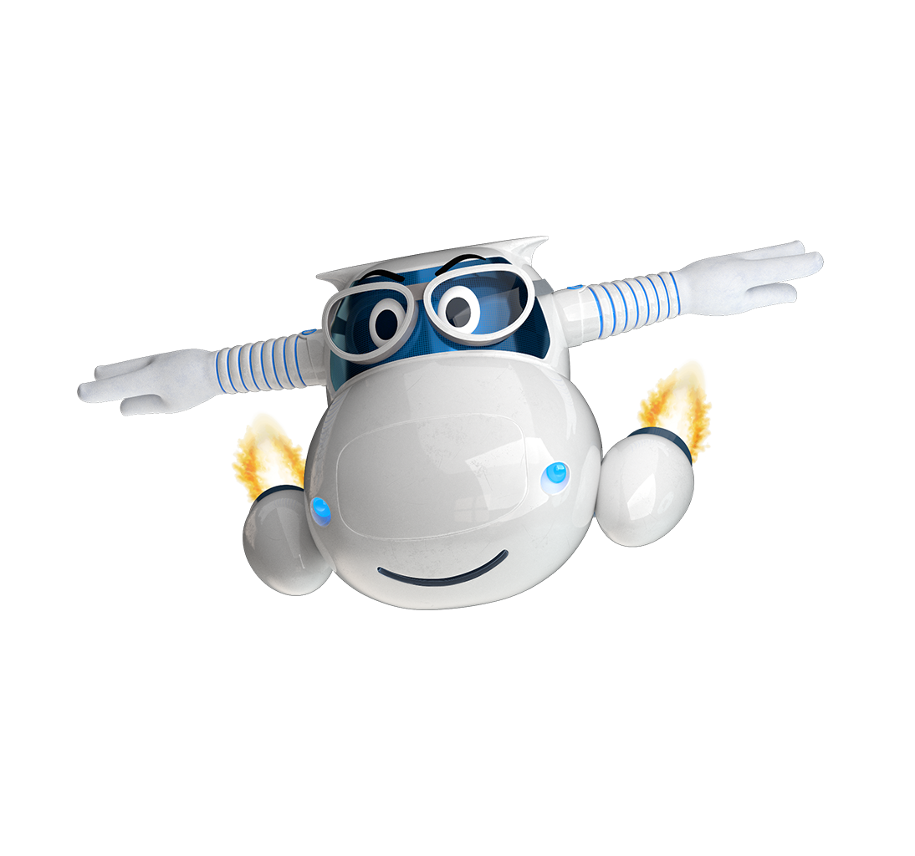
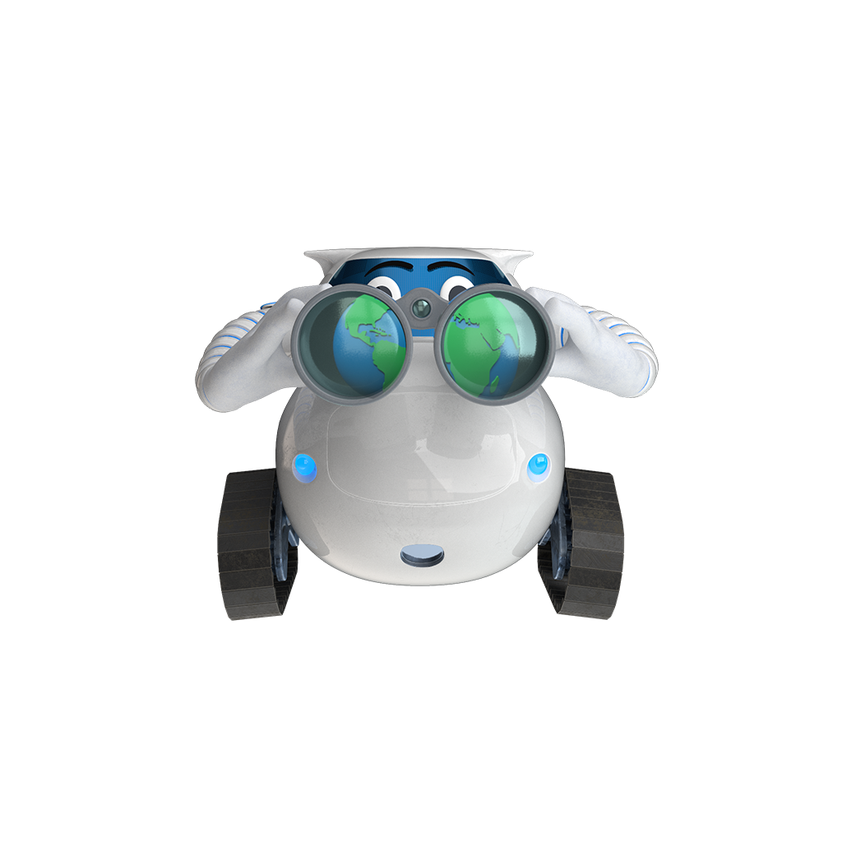
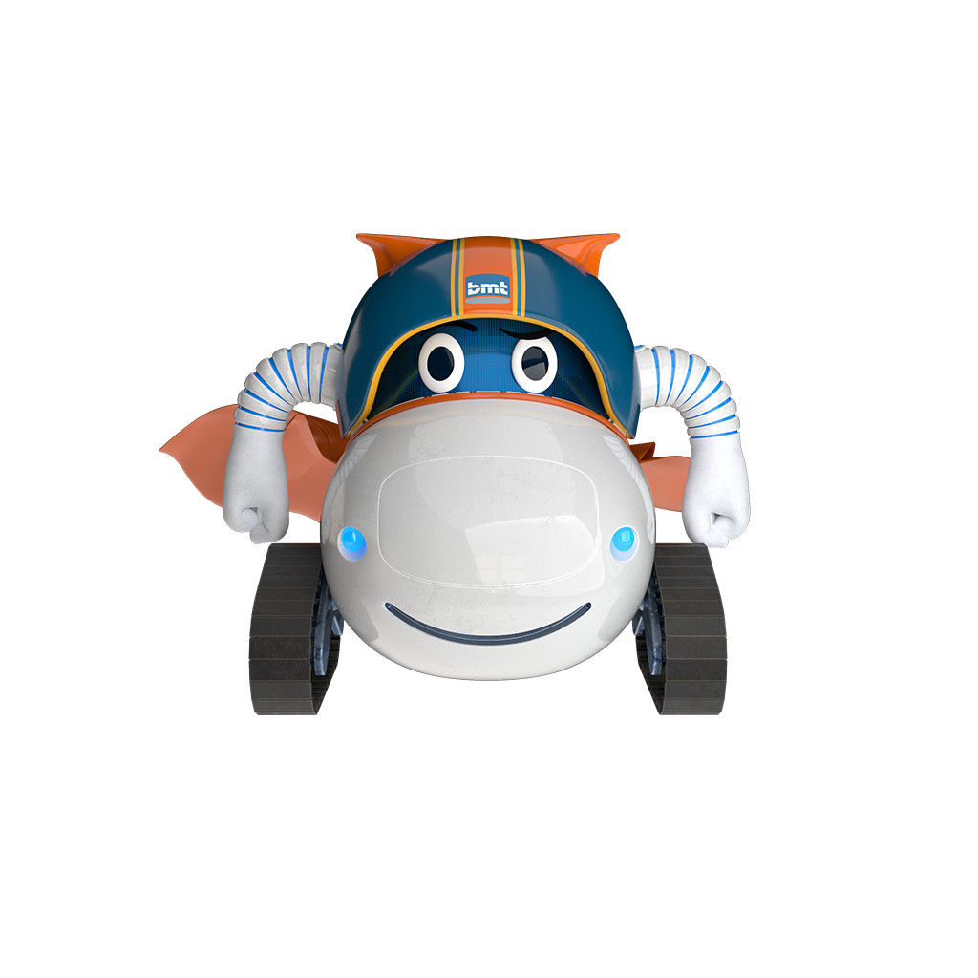
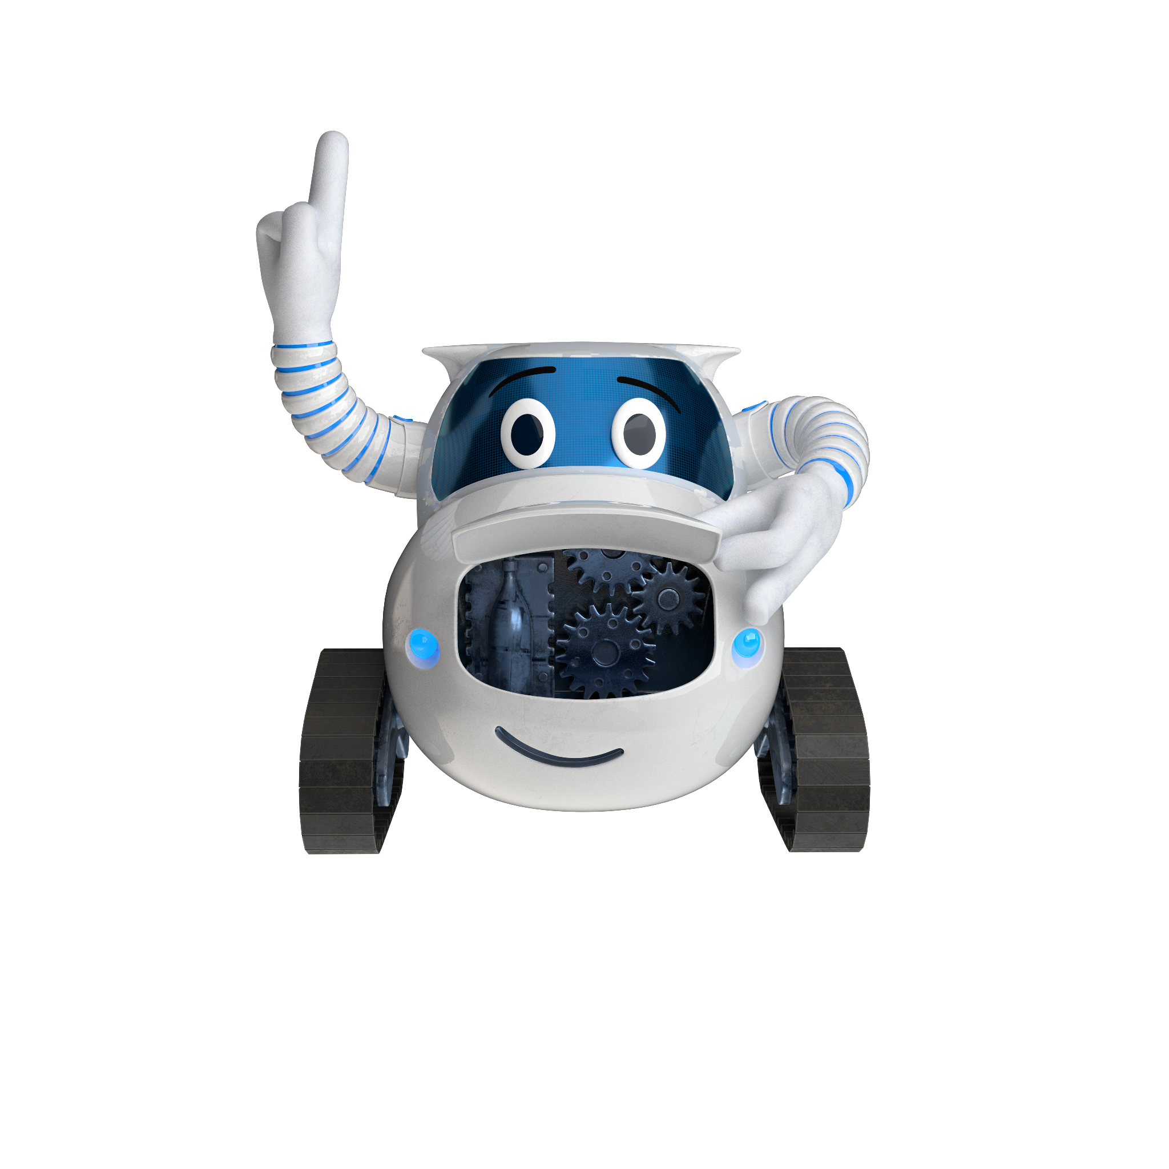
^{Join our family today}
At IGW, we do things differently. We are part of the international BMT group while remaining a close family. All family members keep their focus on what really matters, delivering high-end solutions for our customers. We really are stronger together!
^{Where we are going}
At IGW, we are always moving forth, thinking about the long-term. We invest in our future giving you job security & lots of opportunities to grow.
^{What we offer}
Oostkamp is the head quarters of the industry division who focusses on the production of gears and prismatic parts. For you, that means working in a technical cordial & informal atmosphere.
^{Who we are looking for}
^{Open to}
^{everything}
^{Above all}
^{doers}
^{Proudly obsessed}
We are a human, but professional industrial holding. A worldwide force to reckon with and we like to keep our focus on what really matters.
You dare to take initiative & make things happen by mixing a healthy dose of good old common sense with the newest insights.
We may be pretty laid back about some things but there is not one micron of leeway when it comes to the quality of our service and products.
^{Why you should join us}
^{Flexibility}
Are you an early bird or more like a real snoozer? Both are possible as you can start between 7h and 9h. It’s up to you!
^{Passionate}
People at IGW are proud about what they do, they will explain everything to you with
^{conviction.}
^{No traffic jams}
Our plant is only one kilometer away from the highway in a traffic jam free
^{environment.}
^{Opportunities}
You receive the chance to learn, grow & develop yourself.
Compensation hospitalization insurance, group insurance,
^{competitive salary...}
^{Stronger together}
You are not only part of a local entity. You’re part of a group, one big family who has each others back.
^{Interested?}
Visit our career website https://careers.bmt.be/ or mail your cv to hr@igwpower.com

